Slide 1
Home Page
Plant Waterer Server
Plant Name
Current photo of plant
Soil Moisture Level
Sunlight level
Signal Strength
More Info

Slide 2
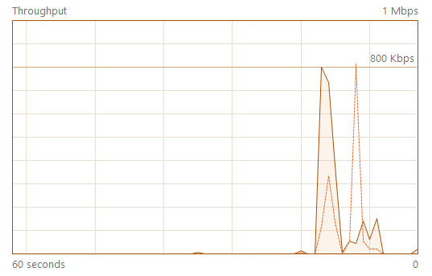
More Info Page
Status
Information
Sensor Status
IP Address
Signal Strength

